Slide 1


Geography
Class VIII

Slide 2

NATURAL RESOURCES
LAND AND SOIL

Slide 3
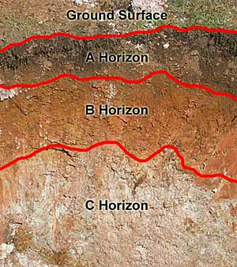
SOIL PROFILE

Slide 4
India land distribution

Slide 5

TYPES OF SOIL IN INDIA

Slide 6

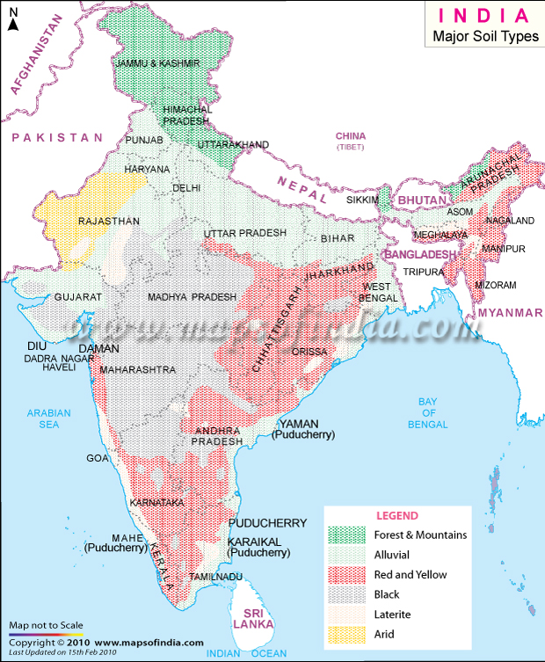
Mountain
Arid
Alluvial
Black soil
Red soil

Slide 7

Samples of different types of soil

Slide 8
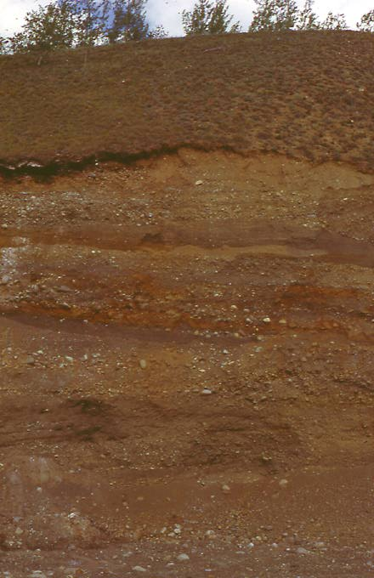
Alluvial soil
The most fertile soil found in the northern plains of India

Slide 9
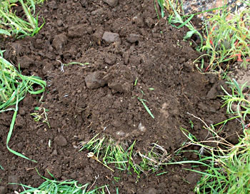
Black soil
Also known as Regur soil found in peninsular India

Slide 10
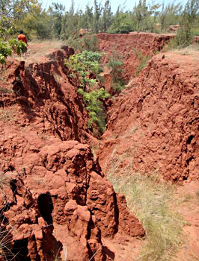
Red soil
Rich in Iron Suitable for wheat and rice

Slide 11
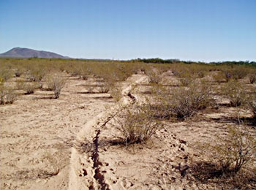
Desert soil
Found in North western India in Rajasthan

Slide 12
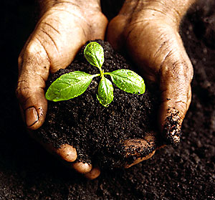
Soil conservation
Terrace farming
Counter ploughing
Control of deforestation
Strip cropping

Slide 13
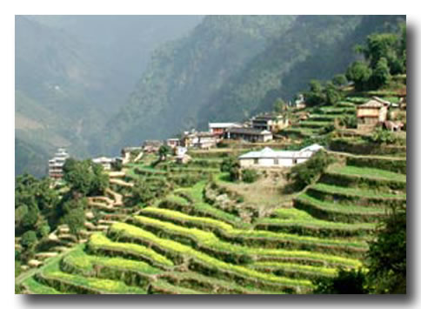
Terrace farming

Slide 14
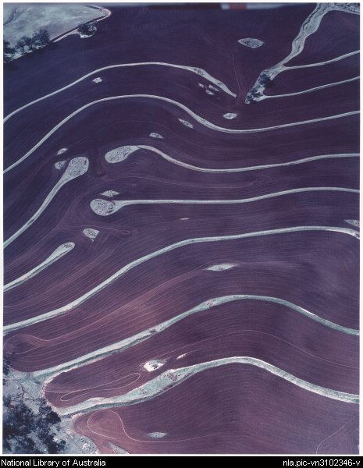
Counter ploughing

Slide 15
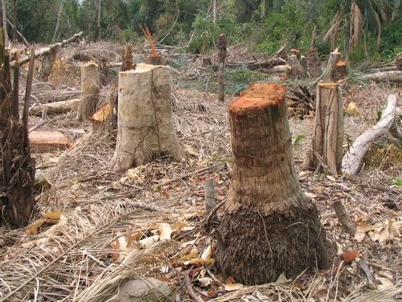
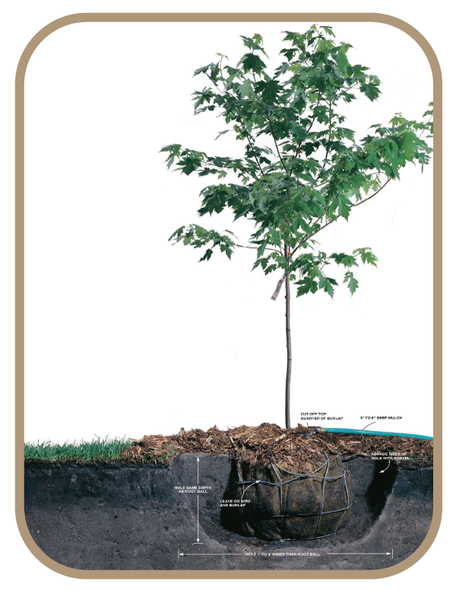
Control of Deforestation

Slide 16
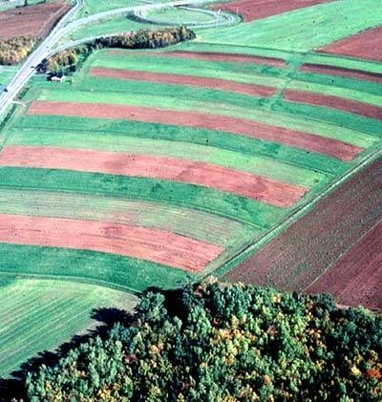
Strip cropping

Slide 17

Thank you
Presentation Prepared by Sreevidhya. s

Slide 18
This powerpoint was kindly donated to
www.worldofteaching.com
Home to well over a thousand free powerpoint presentations submitted by teachers. This a free site. Please visit and I hope it will help in your teaching

